Slide 1
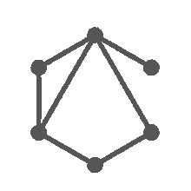
GRAPH NEURAL NETWORKS FOR TEXT EMBEDDINGS
Team 02
Jiwei Pan Ziming Fang
Institute for Parallel and Distributed Systems
University of Stuttgart
17.07.2023

Slide 2
Motivation
Head
Tail
Relation
Knowledge graph
20
7/17/23
/
Notes:
What is a Knowledge Graph? A knowledge graph is a network composed of entities and relationships,
where entities correspond to nodes in the network, and relationships can be understood as different types of edges in the network.
it is represented as a triplet (head, relationship, tail )

Slide 3
Motivation
Stuttgart
Germany
city
Knowledge graph
20
7/17/23
/
Notes:
lests see a simple example:
Stuttgart is a city in Germany. Here, Stuttgart is the head , Germany is the tail , and city is the relationship.

Slide 4
Motivation
Stuttgart
?
city
Knowledge graph
20
7/17/23
/
Notes:
However, for a foreigner, they might not know to which country Stuttgart belongs.
So, how can we use a knowledge graph to help them find the answer?

Slide 5
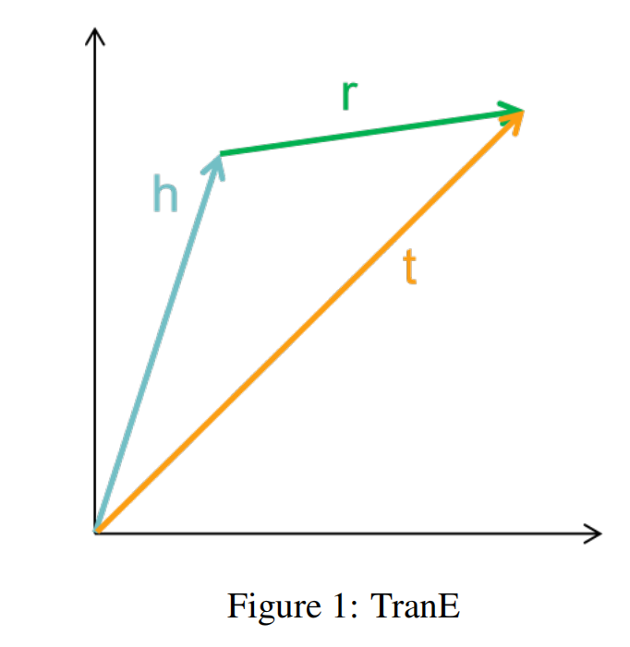
TransE
If i have head and relation, How can I find a tail ?
TransE = |h+r-t|
20
7/17/23
/
Notes:
the same as: If i have head and relation, How can I find a tail ?
TransE is helpful
I will provide a introduction to the TransE model.
the TransE model allows us to obtain an approximate tail entity vector by combining the head entity vector and the relationship vector.
This vector triangle relationship enables us to infer the tail entity.
Next, let's take a look at the specific process and the challenges.

Slide 6
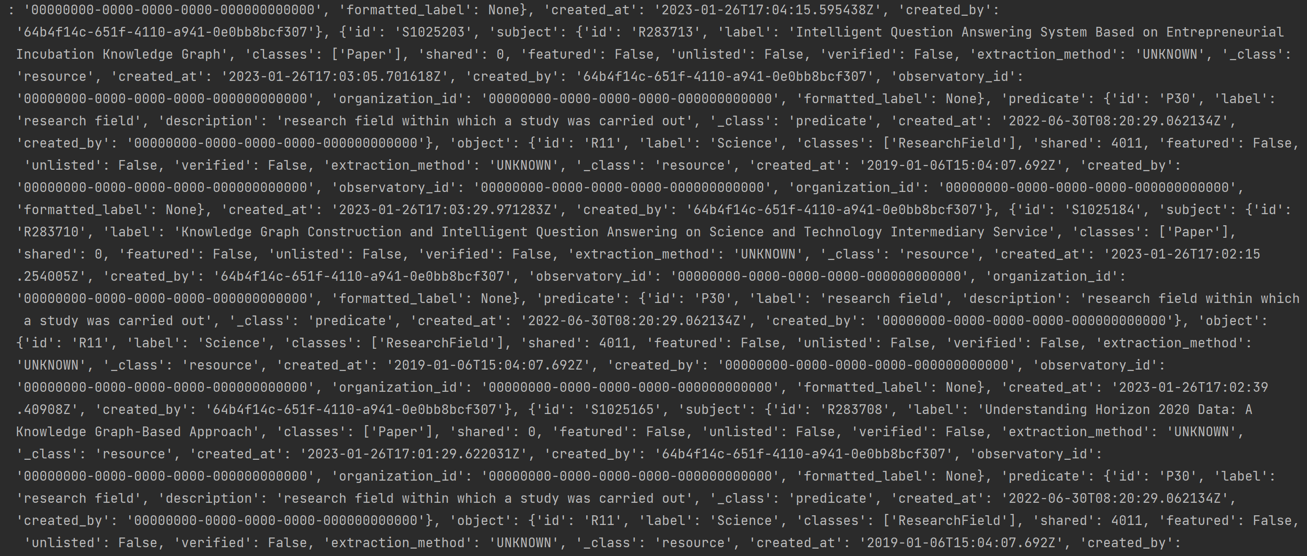
First Challenge
raw dataset
20
7/17/23
/
Notes:
First, we preprocess the dataset.
This is our raw dataset, obtained from a website.
As you can see
It is difficult to identify the positions of the head, relationship, and tail .

Slide 7
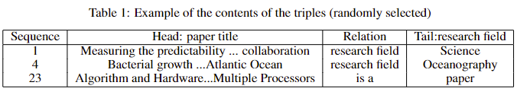
Solution
1. Keyword Information Extraction
2. Delete illegal characters and symbols(regular expression)
3. Check to make sure it's in triplet format
20
7/17/23
/
Notes:
It took us a considerable amount of time to find a solution for cleaning the dataset.
The specific steps we followed are as follows:
1. Keyword Information Extraction
2. Delete illegal characters and symbols(regular expression)
3. Check to make sure it's in triplet format
Below is our processed dataset. We can observe ,head is very very long.

Slide 8
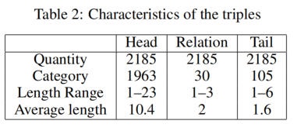
Solution
Quantity: Head ≈ 20 * Tail
Average length：Head ≈ 10 * Tail
Only predict tail entities !
20
7/17/23
/
Notes:
After conducting statistical analysis,
we have 2000 tpyes of head ,however tail is only around 100.
Additionally, the average length of the head entities is ten times greater than that of the tail entities.
Based on these observations, and to better reflect the predictive accuracy of our model,
we have decided to focus only on predicting the tail entities.

Slide 9
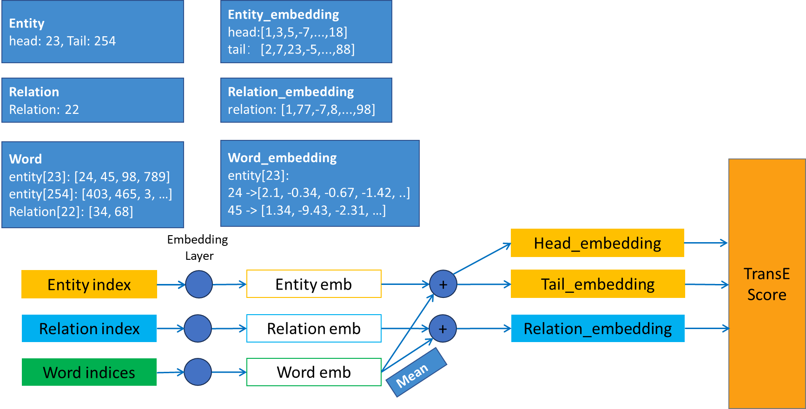
Entity & Word Ebemdding
20
7/17/23
/
Notes:
Based on the features of our dataset, i.e., each entity contains a VERY LARGE number of WORDS, so we introduce a two kinds of embedding layer,
that is, entity embedding AND word embedding.
A brief explanation of embedding for those who do not understand embedding:
When we work with NLP tasks, we often need to convert words, sentences, or other text into a format that computers can understand.
Embedding maps each unique word to a fixed-length vector.
The parameters that control the mapping operation are to be trained.
In the following slides we will illustrate how word and entity embeddings are conducted,
you should be curious about how they combine and why should word embeddings take mean value.

Slide 10
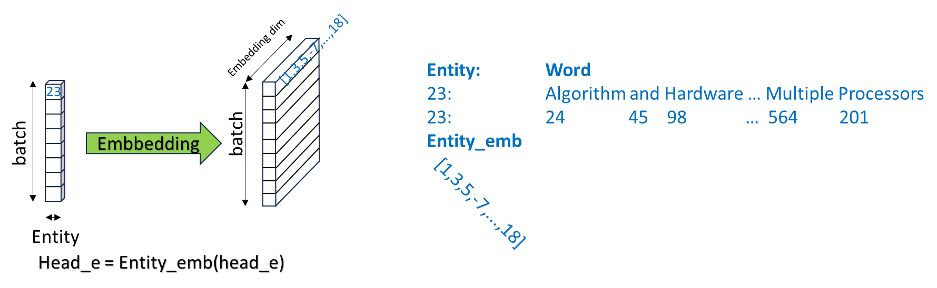
Entity & Word Ebemdding
Entity/Relation
Embedding
Word
Embedding
20
7/17/23
/
Notes:
In this slide, the blue part is an entity example and its containing words. The task are divided into two steps: the first step: entity and relation embedding: a batch contains a bunch of entity index.
The index 23 is embedded into a higher dimension vector [1, 3, 5, -7 and so on].
Other entities do the same. afterwards we get a embedded 2d matrix with size batch times embedding dimension

Slide 11
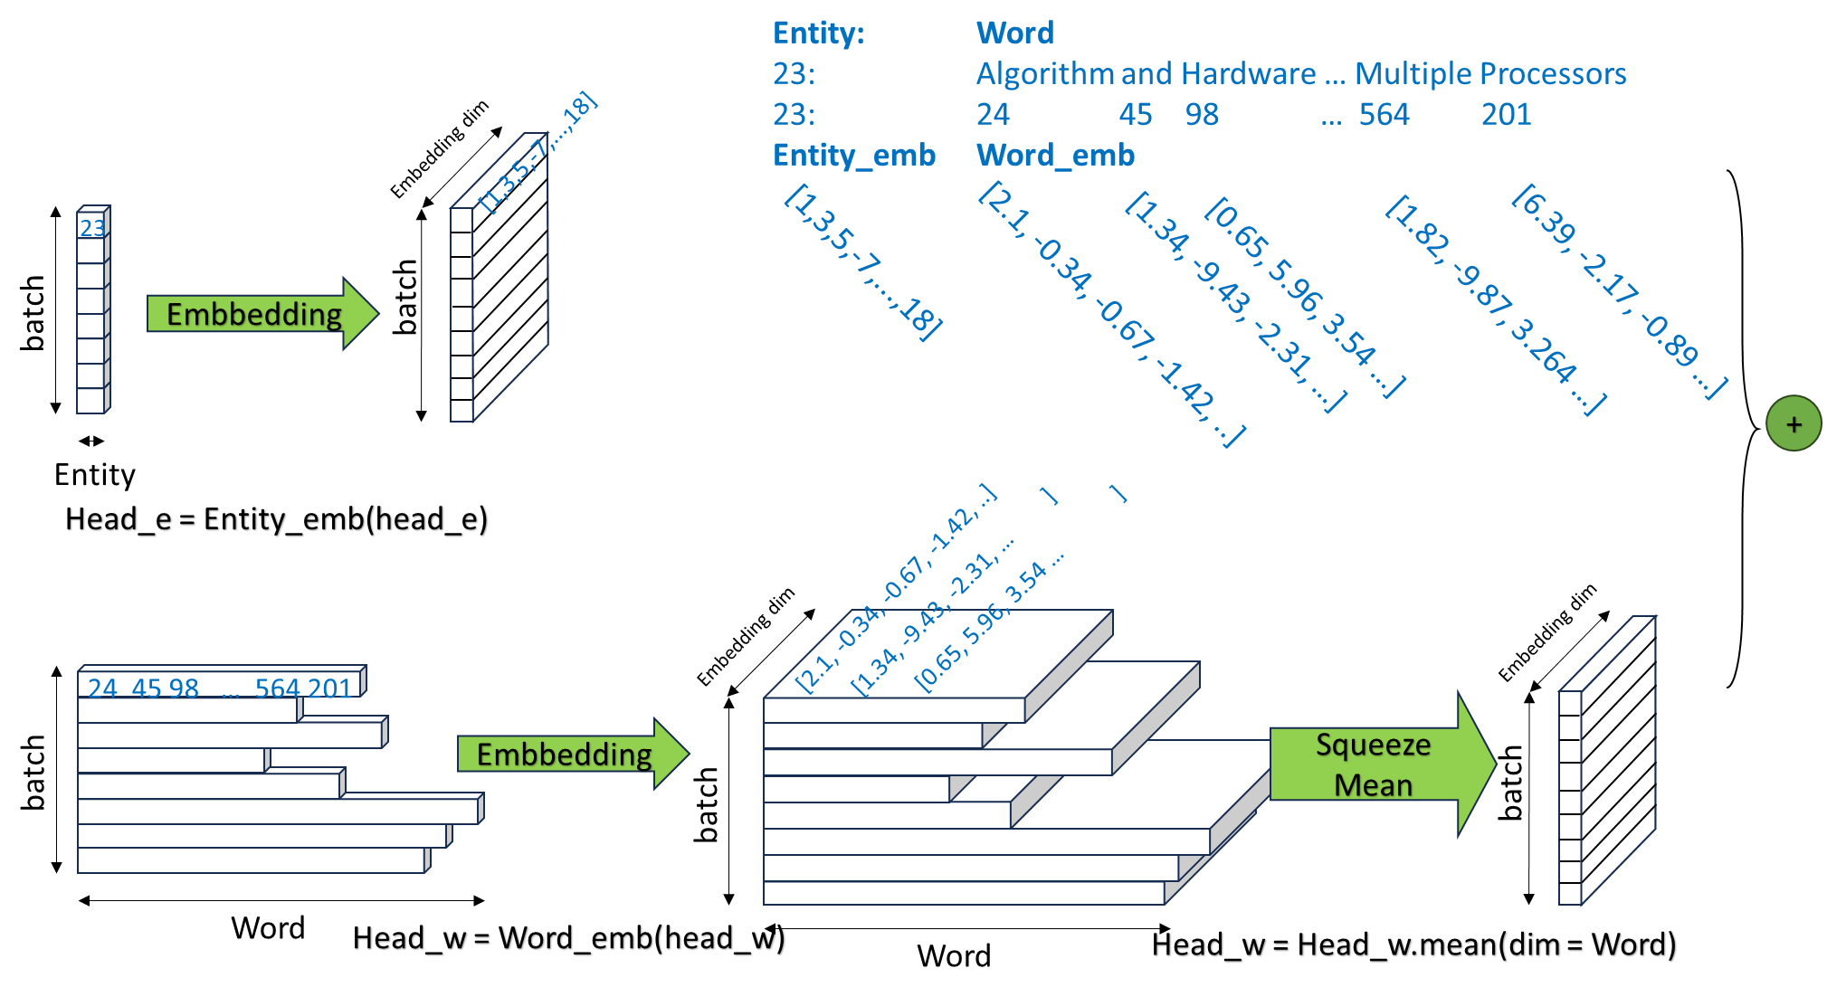
Entity & Word Ebemdding
Entity
Embedding
Word
Embedding
20
7/17/23
/
Notes:
The second step is word embedding. Entity 23 has a bunch of word "algorithm and hardware ... multiple processors".
We first replace each word with its unique index, we get a list with value [24, 45, 98, …].
then we embed these list of words like what we have done in entity embedding. It generate a new dimension.
This new-generated data - like bottom middle diagram - cannot be concidered as a 3d matrix, as each entity has different number of words,
which cause word dimension not aligned to each other, right? So what do we do?
How to fit these type of data structure as input of a transE model so that the transE input contains both entity information AND word information?
So the idea comes now: we shrink the word dimension and compute mean value on this dimension.
Then, we get a matrix with size EXACTLY the same with entity embedding. Since the size is the same, combine these two matrix would not be difficult.
In our case, we simply take addition of these to embedded matrix, then use this matrix as TransE input.

Slide 12
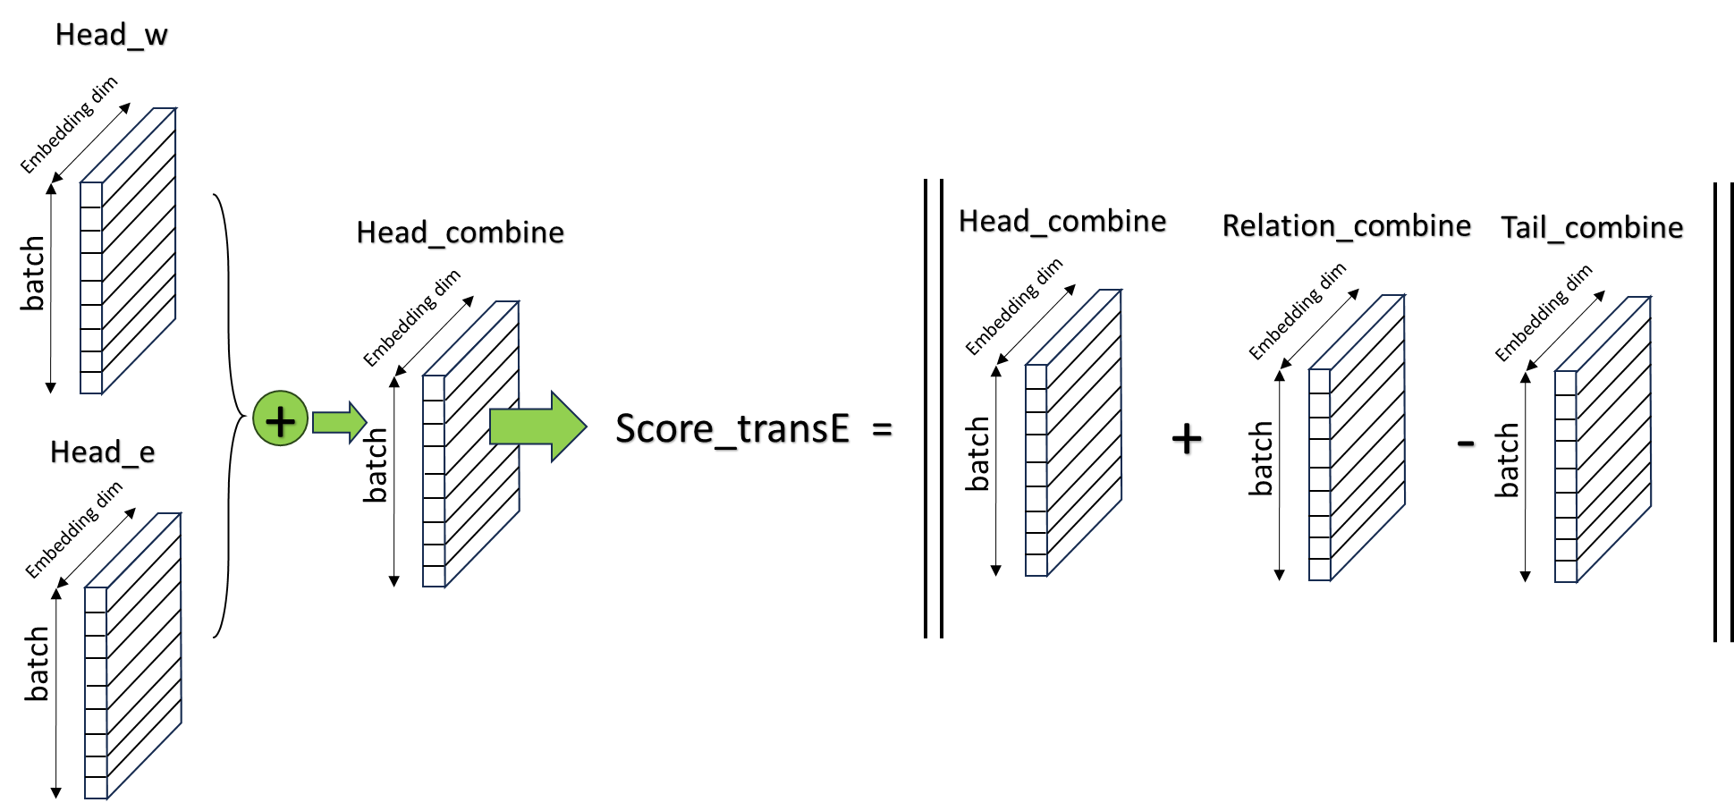
Entity & Word Ebemdding
20
7/17/23
/
Notes:
So we do embedding for head, relation AND. Then we get a new embedded triple output which is also a TransE model input. By using TransE to compute score.

Slide 13
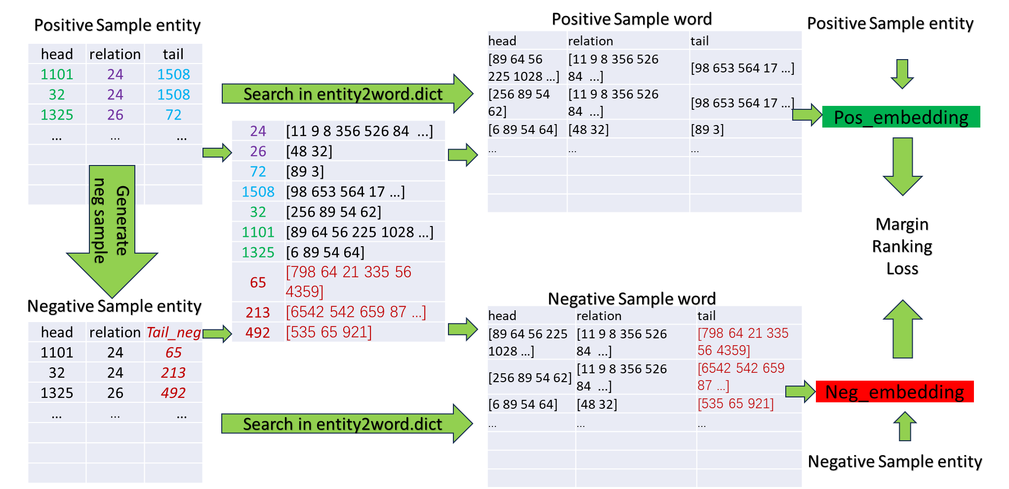
Negative Sample
20
7/17/23
/
Notes:
Previously what we told to you are all true values, but how can model calculate train without negative value?
So for triplet training, we should mannualy generate negative samples.
A negative sample means that the fact that a triple is not correct according to the reality.
So we can simply replace a tail or a head with another different entity, like for entity 1508 replace with 65, also we should replace word right?
for word we replace words of 1508 with words of 65 by searching the corresponding dictionary that stores the correlations between entity and word,
then this pair of triples can be embedded to compute loss now by take minus of the score.

Slide 14
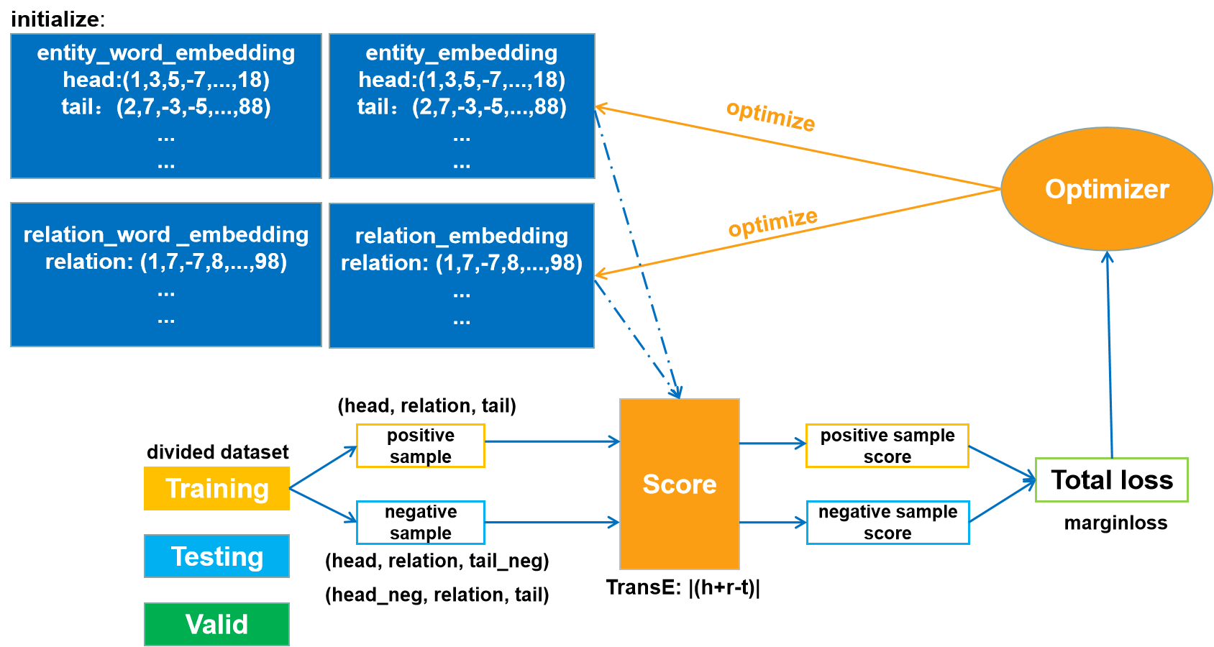
Traning-TransE
The training process of the TransE model
20
7/17/23
/
Notes:
Now let's revisit the TransE model. We now have entity word embeddings and entity embeddings, and we combine them. Additionally, we have corresponding negative samples.
Next, we need to compute the L1 or L2 distance between the embedding matrices of positive and negative samples using the TransE model and score them accordingly.
In this scoring process, the scores are calculated as the negative of the distances.
We aim for the distance of positive samples to be as small as possible, resulting in higher scores and indicating a stronger relationship.
Conversely, we want the distance of negative samples to be as large as possible, leading to lower scores and indicating a weaker or unrelated relationship.

Slide 15
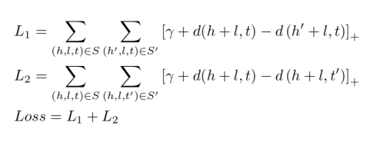
Traning-Marginloss
γ > 0 is a margin hyperparameter.
d(h+ r, t) —— distance： correct triplet (h, r, t).
d(h′+r, t) —— distance： incorrect head entity (h′, r, t).
d(h+r, t′) —— distance： incorrect tail entity (h, r, t′).
20
7/17/23
/
Notes:
Then we use margin loss:
Where γ is the margin hyperparameter, which is the distance constant between the positive sample and the negative sample.
Loss1 is a negative sample for the head entity, and Loss2 is a negative sample for the tail entity.
We combine Loss1+Loss2 to get Totalloss.

Slide 16
Traning-TransE
The training process of the TransE model
20
7/17/23
/
Notes:
Afterwards, use the optimizer to train the neural network, and continuously update the loss function until the loss becomes convergent.

Slide 17
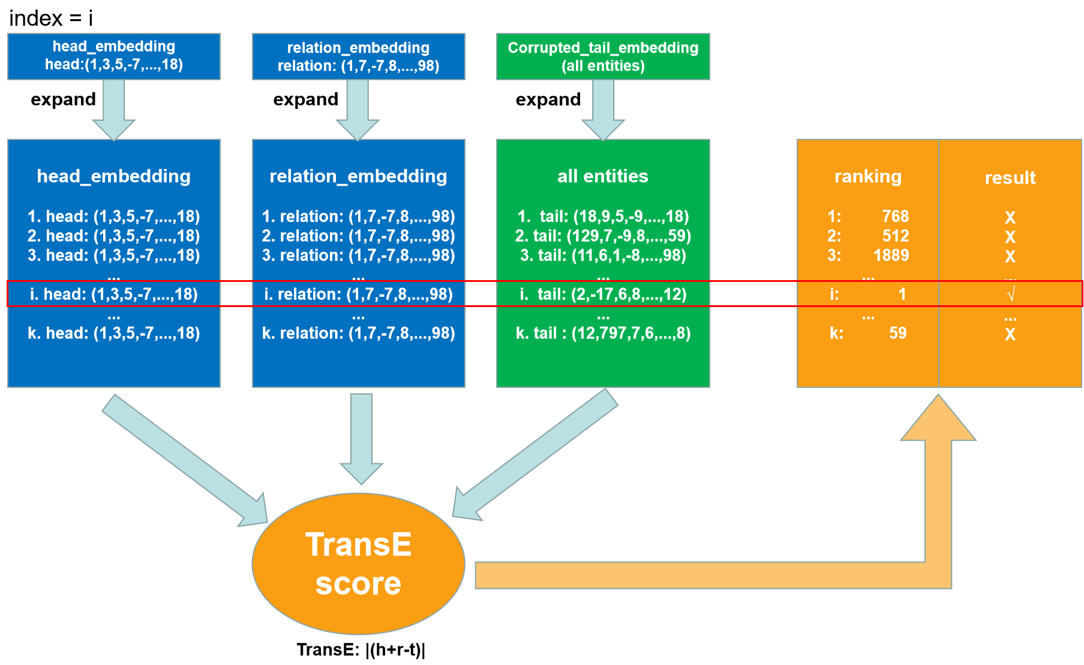
Testing- Ranking
20
7/17/23
/
Notes:
we will move on to the testing part.
After I embed the test set according to the above method, I need to score and rank all the triplets.
How do we achieve rankings? We take the embedding vectors of the head entity and relation of row i as an example.
We first expand the head and relation embedding of this row to k mutiple d.
k is the number of all entities, and d is the embedding dimension.
Then we replace the tail entity with the whole entity. After scoring with TransE, we rank the scores and obtain the best match in the i-th row, which is ranked as 1st.

Slide 18
Result
Model | TransE + Entity/Relation_emb | TransE + Entity/Relation_emb + Word_emb
learning rate | 0,001 | 0,001
dimension | 60 | 60
optimizer | Adam | Adam
gamma | 1 | 1
activationfunction | ReLu | ReLu
margin | 1 | 1
loss | marginrnakingloss | marginrankingloss
negative sample size | 1 | 1
L2 or L1 | L2 | L2
best epoch | 60 | 19
hit@10 | 0,6221 | 0,9354
MRR | 0,3828 | 0,9024
20
7/17/23
/
Notes:
The final test result is shown in this graph. We can clearly see word embedding significantly improves the prediction accuracy of the system, including a
very significant improvement in Hit@10 and MRR value. We also found that the epoch required for model convergence
was also significantly shortened by the inclusion of word embeddings, even with the increase of training parameters.
We believe the reason is that the addition of word embeddings brings a clearer training directivity to the model, which
makes more parameters converge faster Finally we adjust all the parameters listed in this table.
Since the improvement is not that quite significant to the model and the presentation time is limited, so we do not demonstrate here in this presentation.
If you want to check, you can sesarch the result in our project report.

Slide 19
Reference
[1] A. Bordes, J. Weston, R. Collobert, and Y. Bengio. Learning structured embeddings of knowledge bases. In Proceedings of the 25th Annual Conference on Artificial Intelligence (AAAI), 2011.
[2] A. Bordes, N. Usunier, A. Garcia-Duran, J. Weston, and O. Yakhnenko. Translating embeddings for modeling
multi-relational data. In Advances in Neural Information Processing Systems 26, Curran Associates, Inc., 2013, pp.2787–2795.
[3] Z. Wang, J. Zhang, J. Feng, and Z. Chen. Knowledge Graph Embedding by Translating on Hyperplanes. In Proceedings of the AAAI Conference on Artificial Intelligence, vol. 28, no. 1, 2014.
[4] Lisa Ehrlinger and Wolfram Wöß. Towards a Definition of Knowledge Graphs. 2016.
[5] Tomas Mikolov, Ilya Sutskever, Kai Chen, Greg S. Corrado, and Jeff Dean. Efficient estimation of word representations in vector space. In Proceedings of the International Conference on Learning Representations (ICLR), 2013.9
20
7/17/23
/

Slide 20
Thank you for your attention!
Jiwei Pan
Ziming Fang
20
7/17/23
/
Notes:
So this is all about our project. Thank you so much for your attention.

